Slide 1
Access Control
Lecture (9-10)-(11-12)-(13-14)
Dr. Tehsin Kanwal
Assistant Professor

Slide 2
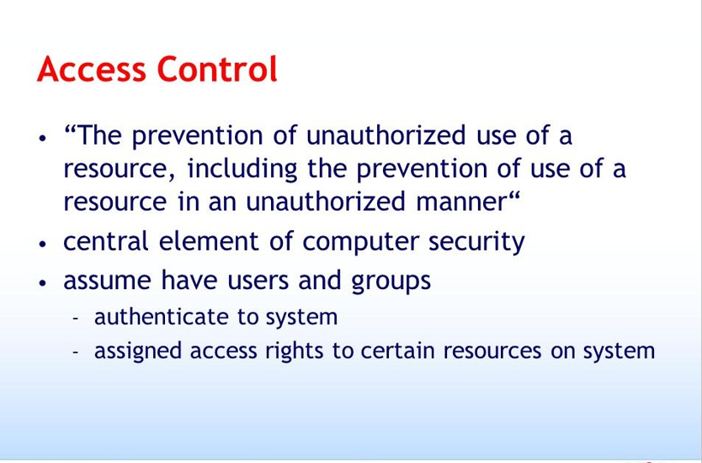

Slide 3
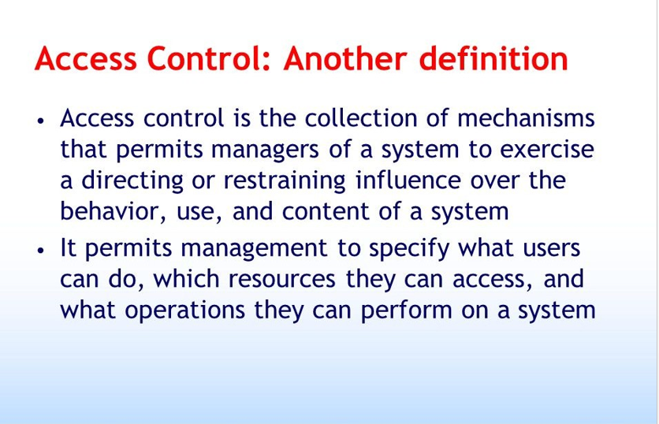

Slide 4
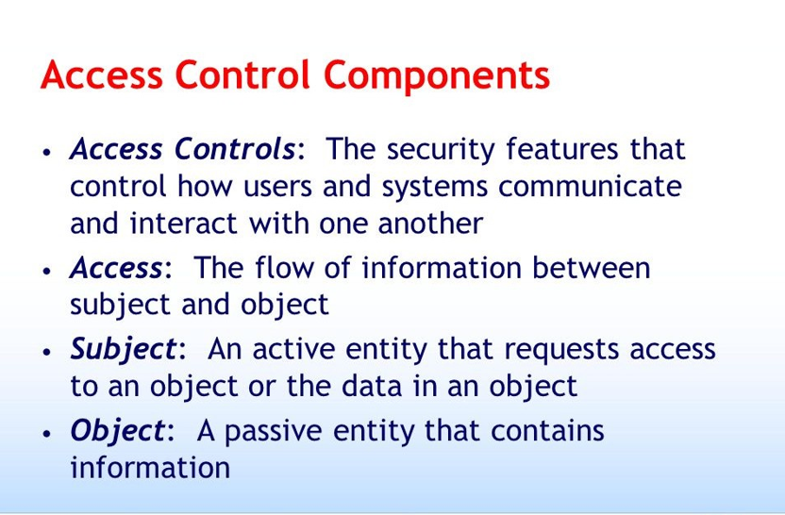

Slide 5
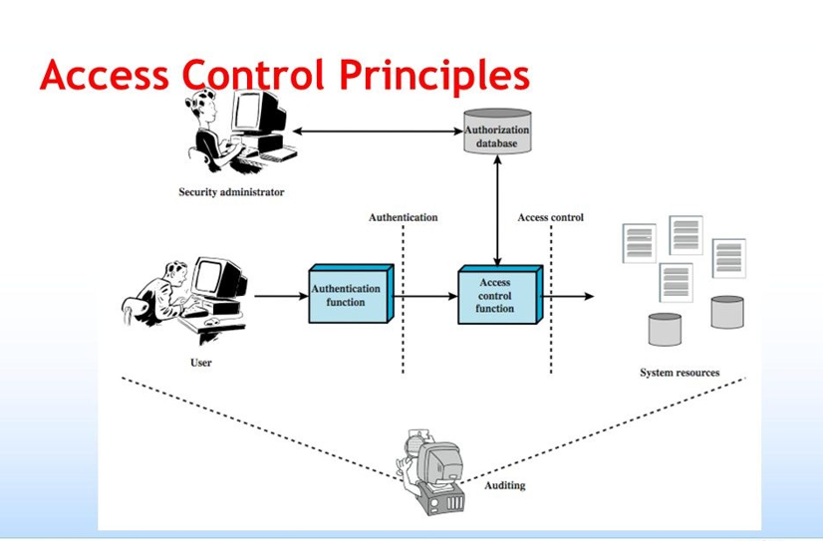

Slide 6
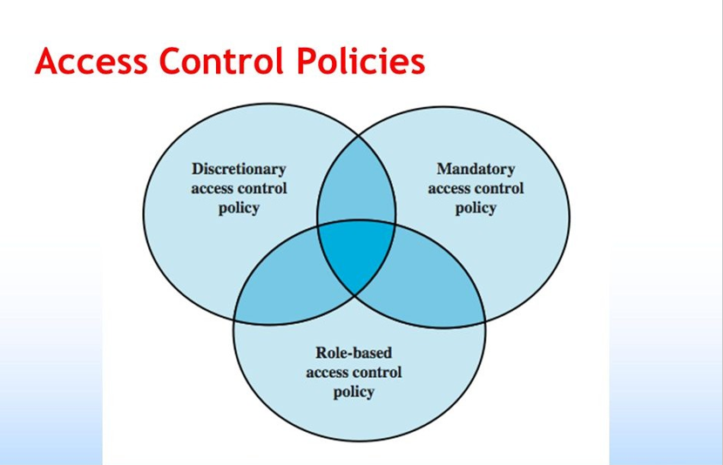

Slide 7
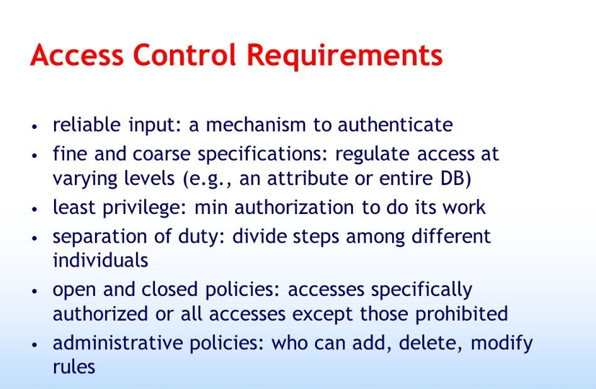

Slide 8
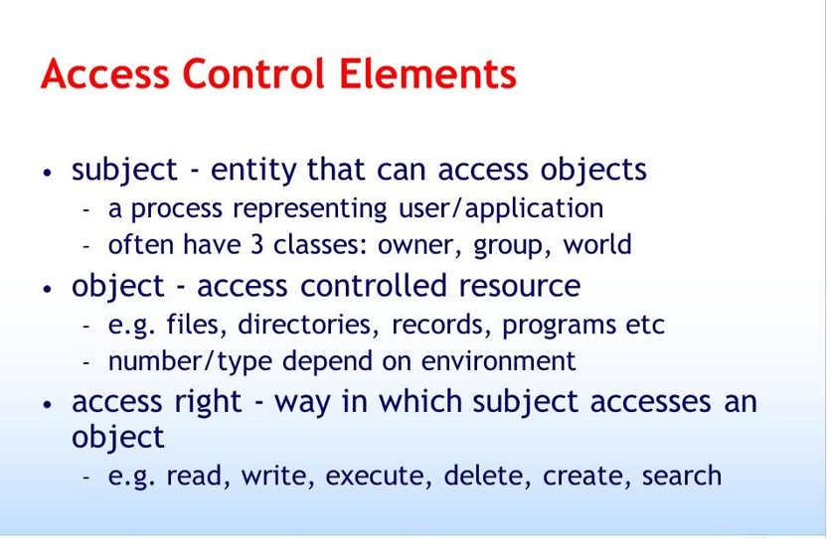

Slide 9
Formal Models of Access Control
Discretionary access control (DAC)—With DAC, the owner of the resource decides who gets in and changes permissions as needed. The owner can give that job to others.
Mandatory access control (MAC)—With MAC, permission to access a system or any resource is determined by the sensitivity of the resource and the security level of the subject. It cannot be given to someone else. This makes MAC stronger than DAC.
Nondiscretionary access control—Nondiscretionary access controls are closely monitored by the security administrator, not the system administrator.
Rule-based access control— A list of rules, maintained by the data owner, determines which users have access to objects

Slide 10
Effects of Breaches in Access Control
The following list details some of the losses that can occur:
• Disclosure of private information
• Corruption of data
• Loss of business intelligence
• Danger to facilities, staff, and systems
• Damage to equipment
• Failure of systems and business processes

Slide 11
Threats to Access Controls
Gaining physical access
Eavesdropping by observation—
Bypassing security
Exploiting hardware and software
Reusing or discarding media
Electronic eavesdropping
Intercepting communication
Accessing networks
Exploiting applications

Slide 12
Operating Systems-Based DAC
Operating systems have primary responsibility for controlling access to system resources such as files, memory, and applications.
One of the main jobs for security administrators is to maintain access controls.
Access controls are effective when they ensure that only authorized users can access resources. They are efficient when they ensure that users can access all the resources they need.
Creating access controls that are both effective and efficient can be challenging.

Slide 13
Application-Based DAC
Application-based DAC denies access based on context or content.
The application presents only options that are authorized for the current user.
For example, an automatic teller machine (ATM) menu limits access by displaying only the options that are available to a particular user.
You can apply security controls using these types of DACs based on user context or resource contents

Slide 14
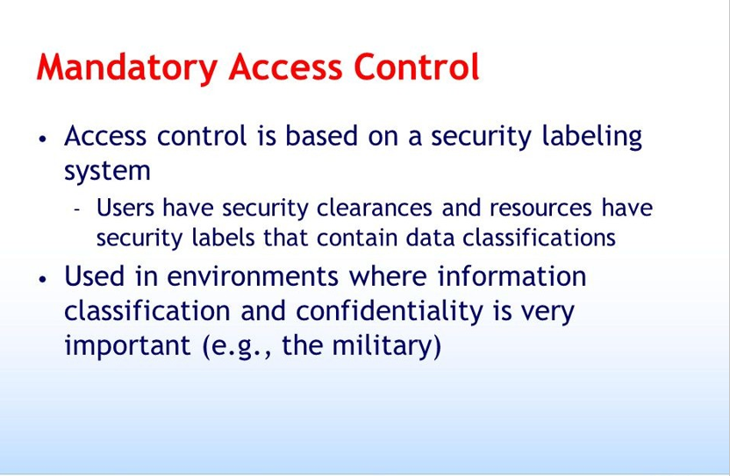

Slide 15
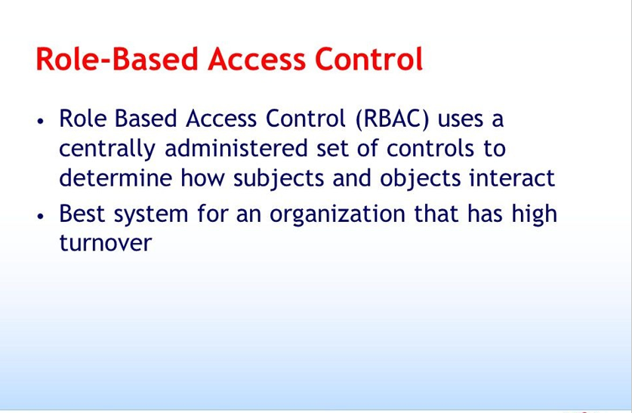

Slide 16
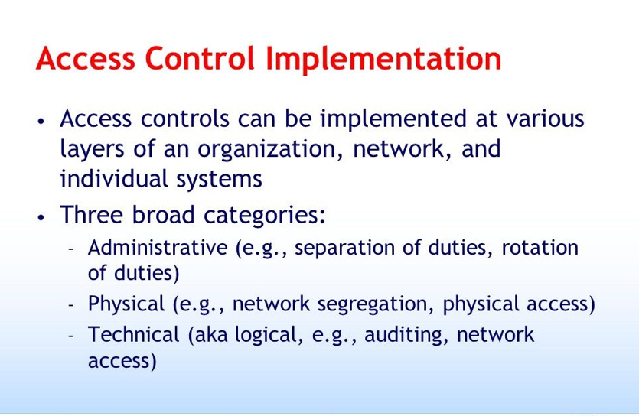

Slide 17
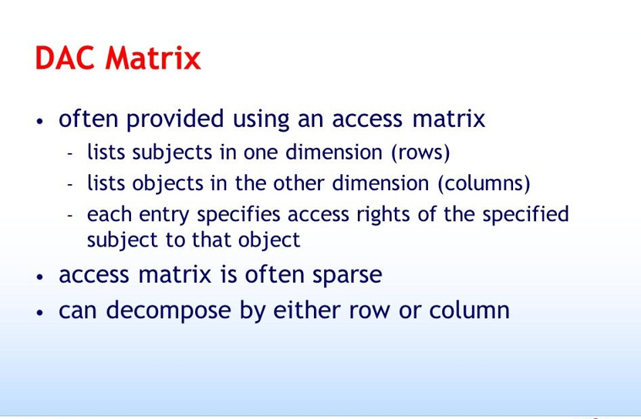

Slide 18
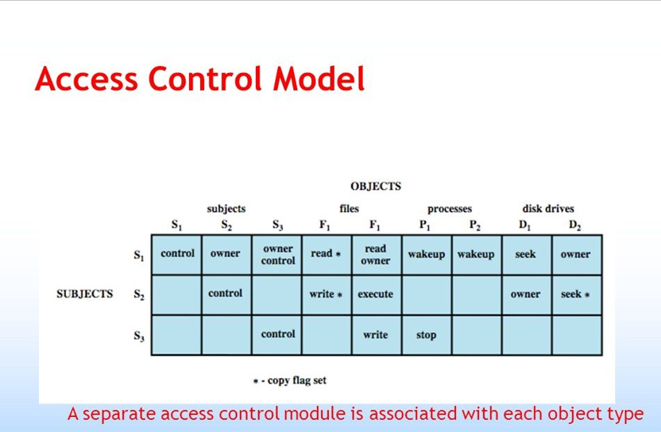

Slide 19
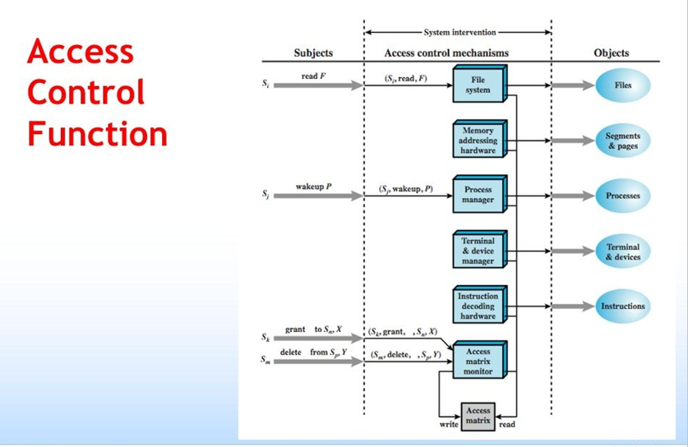

Slide 20
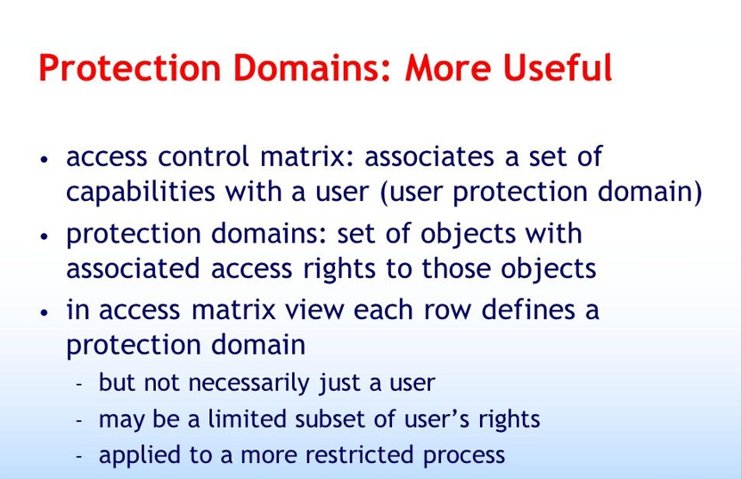

Slide 21
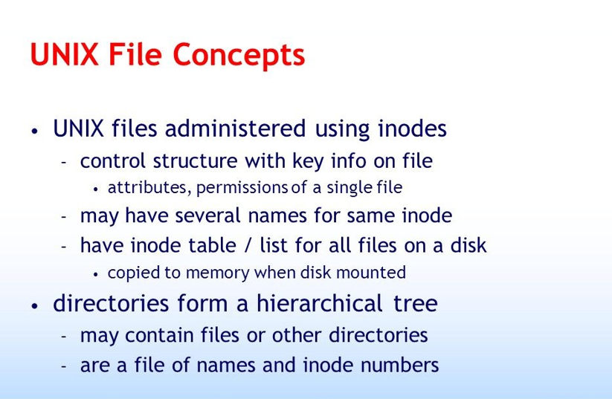

Slide 22
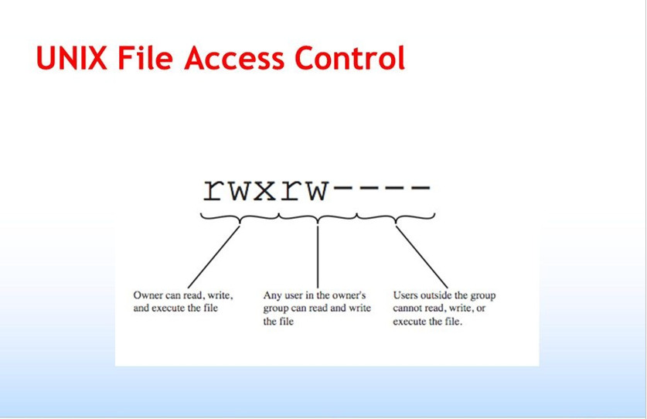

Slide 23
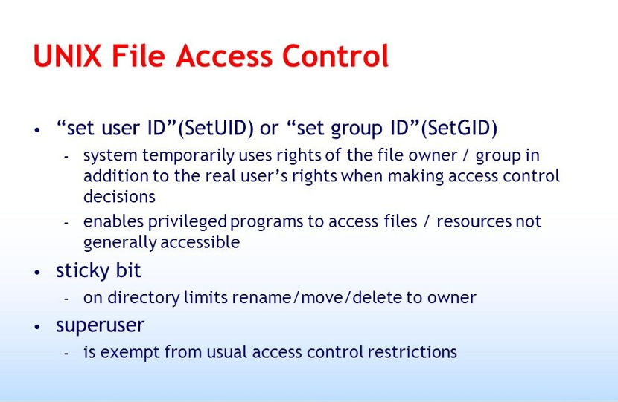

Slide 24
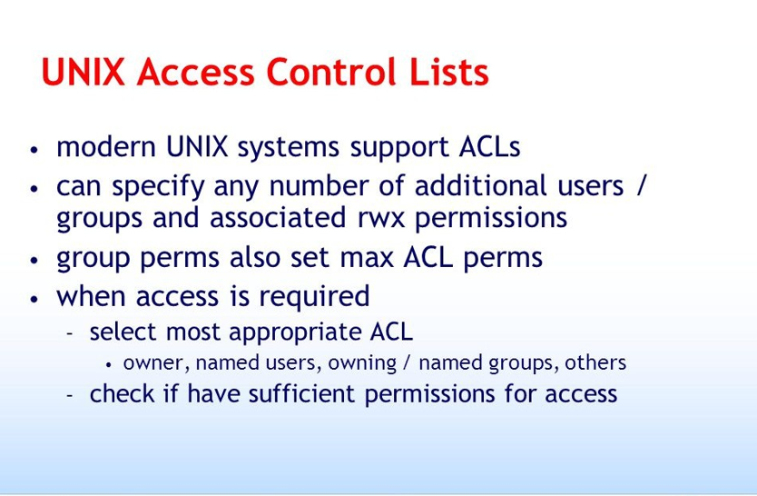

Slide 25
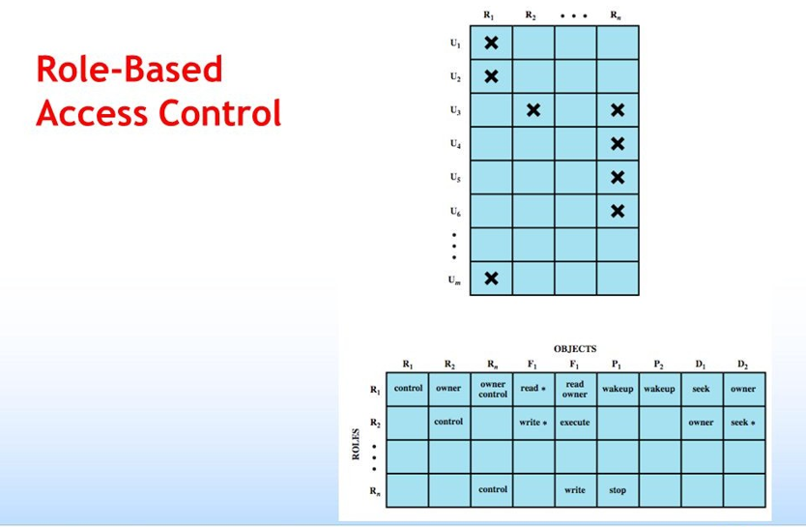

Slide 26
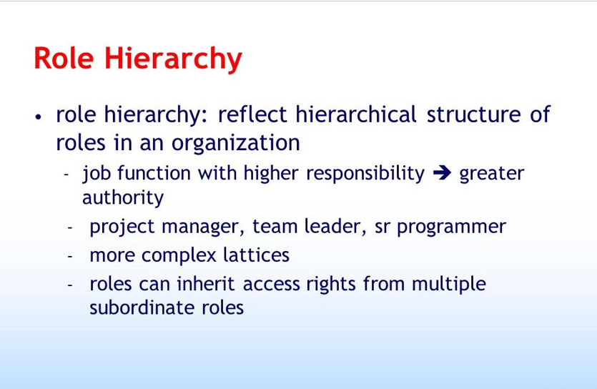

Slide 27
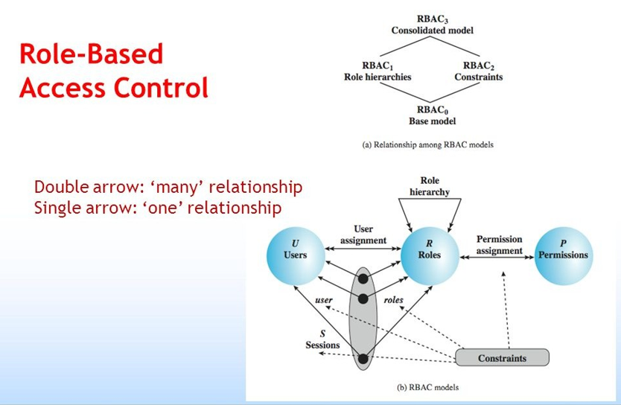

Slide 28
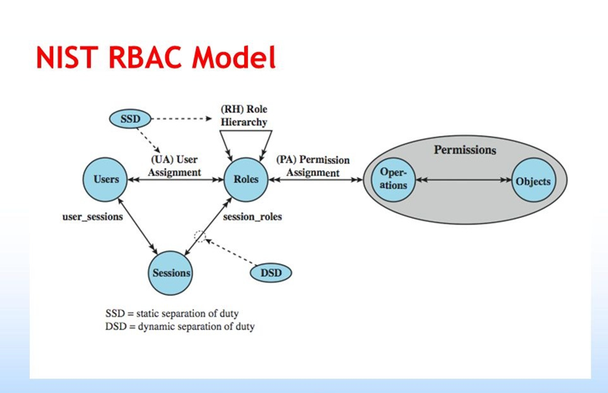

Slide 29
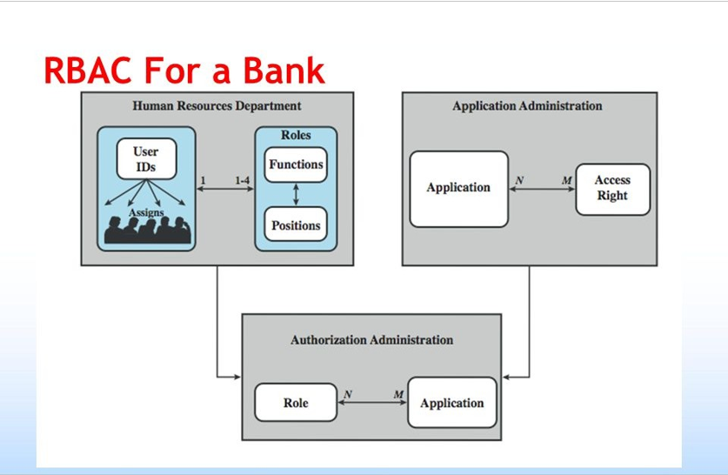
Please see detailed case study at page no 147 from William Stalling Book.

Slide 30
Content-Dependent Access Control
Content dependent access control is based on what is contained in the data.
CDAC requires the access control mechanism (the arbiter program, which is part of the application, not the operating system)
Arbiter program look at the data to decide who should get to see it.
Access is controlled to the record level in a file rather than simply to the file level.
Better granularity.

Slide 31
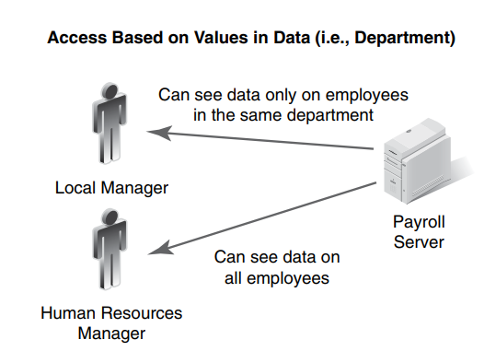
Content-Dependent Access Control

Slide 32
Attribute-based access control (ABAC)
Attribute-based access control (ABAC), also known as policy-based access control for IAM, defines an access control paradigm whereby a subject's authorization to perform a set of operations is determined by evaluating attributes associated with the subject, object, requested operations, and, in some cases, environment attributes.
ABAC is a method of implementing access control policies that is highly adaptable and can be customized using a wide range of attributes, making it suitable for use in distributed or rapidly changing environments.
The only limitations on the policies that can be implemented with ABAC are the capabilities of the computational language and the availability of relevant attributes. ABAC policy rules are generated as Boolean functions of the subject's attributes, the object's attributes, and the environment attributes.
Notes:
Identity management (IdM), also known as identity and access management, is a framework of policies and technologies to ensure that the right users have the appropriate access to technology resources. IdM systems fall under the overarching umbrellas of IT security and data

Slide 33
Rule-Based Access Control
In a rule-based system, access is based on a list of rules that determine who should be granted access.
Data owners make or allow the rules. They specify the privileges granted to users, such as read, write, execute.
The success of rule-based access control depends on the level of trust you have with the data owners.
It doesn’t work as well in environments with many users or where users lack the necessary technical skills and training. FIGURE 5-3 shows how individual rules control each user’s permissions.

Slide 34
Risk-Adaptive Access Control
In the RAdAC (Risk-Adaptive Access Control) model, access control is adaptive and based on the calculation of the risk of access to the system that the user performs.
Risk is the potential damage that can arise in a current or future process and is generally represented by the probability of an unwanted event and its resulting impact .
The access control models based on risk conduct a risk analysis in the request to make an access decision.
This risk analysis can be qualitative or quantitative. In the qualitative methods different scales of risk, such as high, average and low ranges are used, and usually the valuation is done by an expert opinion. Yet, in quantitative methods there is a way to assign a numeric value that represents the risk of a request for access.
In quantitative methods, the risk of an event is usually represented by the calculation expressed in formula (1). R = P x I (1)
This calculation is made in real time and should guarantee the system security.

Slide 35
Centralized and Decentralized Access Control
Centralized access control is an access control approach in which a single common entity such as an individual, department, or device—decides who can get into systems and networks.
The access controls are managed centrally rather than at the local level.
Owners decide which users can get to which objects. The central administration supports the owners’ directives.
Centralized authentication services are applied and enforced through the use of authentication, authorization, and accounting

Slide 36
Centralized Access Control
Benefits
Drawbacks
It involves less administration time because user accounts are maintained on a single host.
It reduces design errors because different access devices use similar formats.
It reduces security administrator training because only one system is learned.
It improves and eases compliance auditing because all access requests are handled by one system.
It reduces help-desk calls because the user interface is consistent
Centralized access control is generally simpler to manage
the drawback is that if it fails, large numbers of user can be affected and unable to get into the computer system.

Slide 37
Decentralized Access Control
Another access control approach is to handle access control decisions and administration locally.
This approach is called decentralized access control. That means access control is in the hands of the people, such as department managers who are closest to the system users.
Password Authentication Protocol (PAP), which uses clear text usernames and passwords,
Challenge-Handshake Authentication Protocol (CHAP). CHAP is more secure than PAP since it hashes the password with a one-time challenge number to defeat eavesdropping-based replay attacks

Slide 38
Centralized Access Control
Benefits
Drawbacks
On the other hand, a decentralized approach eliminates the single-point-offailure problem.
It ends the perception that a central controlling body cannot respond effectively to local conditions.
It involves less administration time because user accounts are maintained on a single host.
Decentralized access control often results in confusion. Because it can lead to loss of standardization and to overlapping rights.

Slide 39
Business Drivers for Access Control
Business Requirements:
Good Policies: Policies are where we start, because they name the assets we are protecting, they tell us why we are protecting them, and they usually tells us what to do. They should be clearly written, so they can be followed without confusion. The text also points out that controls, procedures that support policies.
Senior Management: should act as role models. Make that all levels of management, because a policy need support from all levels. Requiring each person who enters a secure site to be admitted only after their ID badge has been properly scanned.
This is a hard control to implement, because people do not like it. Let the doors to the site open to turnstiles. To pass through, employees must scan their ID badges on an ID scanner incorporated into each turnstile. This makes each individual scan their own badge without closing a door in someone's face. It also speeds up the entry process, because there is more than one scanner at each door. A nearby security guard processes admission for people who need help.

Slide 40
Sandboxing
A sandbox is an isolated testing environment that enables users to run programs or open files without affecting the application, system or platform on which they run.
Software developers use sandboxes to test new programming code. Cybersecurity professionals use sandboxes to test potentially malicious software. Without sandboxing, software or applications could have potentially unlimited access to all the user data and system resources on a network.
Sandboxing protects an organization's critical infrastructure from suspicious code because it runs in a separate system. It also allows IT to test malicious code in an isolated testing environment to understand how it works as well as more rapidly detect similar malware attacks.
Using a sandbox to test software changes before they go live means there are fewer problems during and after testing because the testing environment is totally separate from the production environment.
In general, a sandbox is used to test suspicious programs that may contain viruses or other malware, without allowing the software to harm the host devices.
Sandboxing also complements other security programs, including behavior monitoring and virus programs. It offers added protection against certain strains of malware that an antivirus program may not detect.

Slide 41
Sandbox: Examples
Web browsers. A trusted web browser can be run inside a sandbox. Then if a website exploits a vulnerability in that web browser, the damage is limited to the sandbox and minimized.
Security research. Information security professionals use sandboxes for research or to detect malicious code. For instance, a security tool could visit websites to monitor what files are ultimately changed.
Virtualization. A VM is basically a type of sandbox. This approach uses a VM-based sandbox to contain and examine suspicious programs.
Sandbox applications include:
Browser plug-in content often depended on using a sandbox to screen content loaded by browser plug-ins, Adobe Flash.
PDFs and other documents may include executable code, so Adobe Reader Protected Mode runs PDF files in a sandbox.
Mobile apps are generally executed by mobile platforms in sandboxes.

Slide 42
Network Access Control
Network access control is the act of keeping unauthorized users and devices out of a private network.
Network security protects the functionality of the network, ensuring that only authorized users and devices have access to it, that those devices are clean, and that the users are who they say they are.
Network access control, or NAC, is one aspect of network security. There are many NAC tools available, and the functions are often performed by a network access server.

Slide 43
What are advantages of network access control?
One advantage of network access controls is that users can be required to authenticate via multi-factor authentication, which is much more secure than identifying users based on IP addresses or username and password combinations.
Secure network access control also provides additional levels of protection around individual parts of the network after a user has gained access, ensuring application security. Some network access control solutions may include compatible security controls such as encryption and increased network visibility.

Slide 44
What are the capabilities of network access control?
One important function of network access control is limiting network access to both specific users and specific areas of the network.
Network access control can also prevent unauthorized access to data by employees. In this way, an employee that needs to access the corporate intranet still won’t get access to sensitive customer data unless their role warrants it and they have been authorized for that access.
In addition to limiting user access, a network access control also blocks access from endpoint devices that do not comply with corporate security policies. This ensures that a virus cannot enter the network from a device that originates from outside of the organization.

Slide 45
What are the types of network access control?
There are two basic types of network access control :
Pre-admission: The first type of network access control is called pre-admission because it happens before access to the network is granted, when a user or endpoint device initiates a request to access a network.
A pre-admission network control evaluates the access attempt and only allows entry if the device or user making the request can prove they are in compliance with corporate security policies and are authorized to access the network.
Post-admission: Post-admission network access control happens within the network, when the user or device tries to enter a different part of the network.
If the pre-admission network access control fails, the post-admission network access control can restrict lateral movement within the network and limit the damage from a cyber attack. A user or device must re-authenticate upon each request to move to a different part of the network.

Slide 46
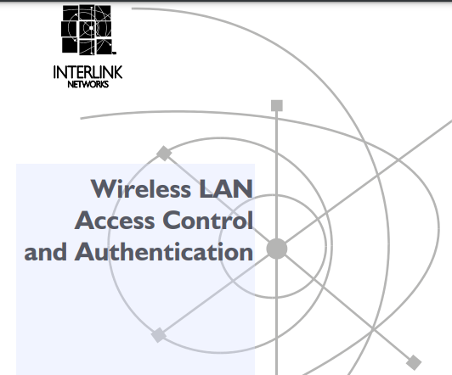
Reading Assignment: Access Control to IEEE 802.11 WLANs
Read the attached article form page 1-10

Slide 47
References
Kim, David, and Michael G. Solomon. Fundamentals of information systems security. Jones & Bartlett Publishers, 2010.
Stallings, William, et al. Computer security: principles and practice. Vol. 3. Upper Saddle River: Pearson, 2012.
Available at: https://en.wikipedia.org/wiki/Attribute-based_access_control
Marinho, Roberto, Carla Merkle Westphall, and Gustavo Roecker Schmitt. "A Dynamic Approach to Risk Calculation for the RAdAC Model." Proceedings of the International Conference on Security and Management (SAM). The Steering Committee of The World Congress in Computer Science, Computer Engineering and Applied Computing (WorldComp), 2014.
Available at: https://www.vmware.com/topics/glossary/content/network-access-control.html#:~:text=In%20addition%20to%20limiting%20user,from%20outside%20of%20the%20organization.

